Slide 1
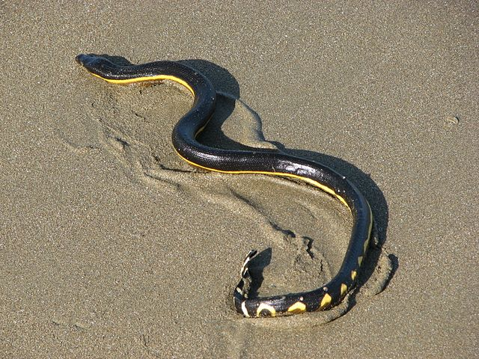
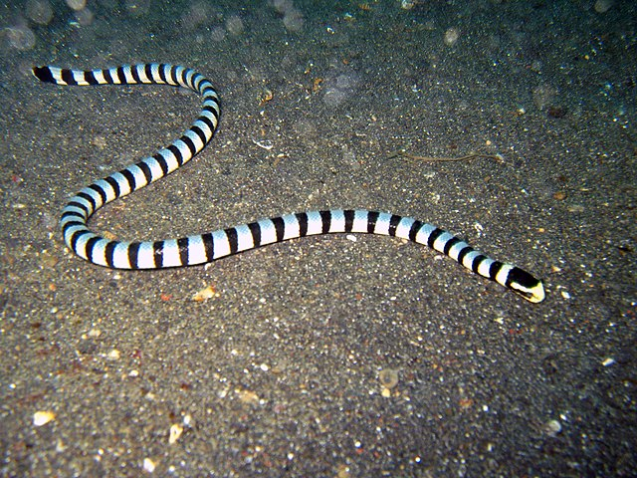
R workshop
Does adaptation to the marine environment affect the speciation rate of elapid snakes?
This will take place in R or R studio
Save the BiSSE_elapids folder and set working directory

Slide 2

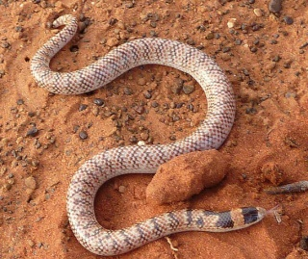
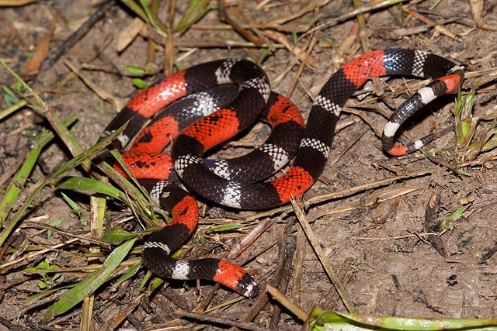
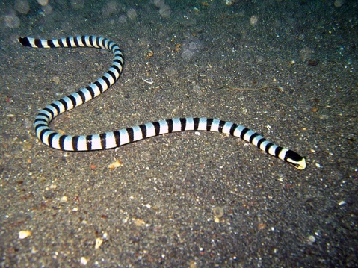
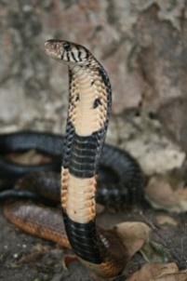
Input – a molecular phylogeny of venomous snakes

Slide 3
Load packages and data
install.packages("diversitree")
install.packages("phangorn")
library(diversitree)
library(phangorn)
tree <- read.nexus("elapids.tree")
df <- read.csv("habitats.csv")
v <- df[,2]
names(v) <- df[,1]
BiSSE requires a nexus tree and the character data for each species
The last two lines of code are simply to get the habitat data in the correct format

Slide 4
Set up a BiSSE model
install.packages("diversitree")
install.packages("phangorn")
library(diversitree)
library(phangorn)
Tree <- read.nexus("elapids.tree")
df <- read.csv("habitats.csv")
v <- df[,2]
names(v) <- df[,1]
bisse6 <- make.bisse(tree, v)
start <- starting.point.bisse(tree)
ml6 <- find.mle(bisse6, start)
The first line sets up a full 6 parameter BiSSE model but does not run it
Starting point provides initial parameter values for the likelihood search
find.mle initiates a run to find the maximum likelihood estimate for the parameters. This will take a few seconds to run

Slide 5
Set up two constrained models
install.packages("diversitree")
install.packages("phangorn")
library(diversitree)
library(phangorn)
Tree <- read.nexus("elapids.tree")
df <- read.csv("habitats.csv")
v <- df[,2]
names(v) <- df[,1]
bisse6 <- make.bisse(tree, v)
Start <- starting.point.bisse(tree)
ml6 <- find.mle(bisse6, start)
bisse5 <- constrain(bisse6, mu1 ~ mu0)
bisse4 <- constrain(bisse6, lambda1 ~ lambda0, mu1 ~ mu0)
ml5 <- find.mle(bisse5, start)
ml4 <- find.mle(bisse4, start)
6 parameter
(full BiSSE model)
λ
μ
0
state
1
5 parameter model
(equal extinction)
λ
μ
0
state
λ
1
4 parameter model
(equal speciation and extinction)
λ
μ
0
state
1
state

Slide 6
Now have a look at the likelihood value of the results
install.packages("diversitree")
install.packages("phangorn")
library(diversitree)
library(phangorn)
Tree <- read.nexus("elapids.tree")
df <- read.csv("habitats.csv")
v <- df[,2]
names(v) <- df[,1]
bisse6 <- make.bisse(tree, v)
Start <- starting.point.bisse(tree)
ml6 <- find.mle(bisse6, start)
bisse5 <- constrain(bisse6, mu1 ~ mu0)
bisse4 <- constrain(bisse6, lambda1 ~ lambda0, mu1 ~ mu0)
ml5 <- find.mle(bisse5, start)
ml4 <- find.mle(bisse4, start)
ml6$lnLik
ml5$lnLik
ml4$lnLik
The maximum likelihood for the 5 parameter model is lower than for the 4 parameter model
Why is that?

Slide 7
Try alternative starting parameters
install.packages("diversitree")
install.packages("phangorn")
library(diversitree)
library(phangorn)
Tree <- read.nexus("elapids.tree")
df <- read.csv("habitats.csv")
v <- df[,2]
names(v) <- df[,1]
bisse6 <- make.bisse(tree, v)
Start <- starting.point.bisse(tree)
ml6 <- find.mle(bisse6, start)
bisse5 <- constrain(bisse6, mu1 ~ mu0)
bisse4 <- constrain(bisse6, lambda1 ~ lambda0, mu1 ~ mu0)
ml5 <- find.mle(bisse5, start)
ml4 <- find.mle(bisse4, start)
ml6$lnLik
ml5$lnLik
ml4$lnLik
start <- ml6$par
ml6.1 <- find.mle(bisse6, start)
ml5.1 <- find.mle(bisse5, start)
ml4.1 <- find.mle(bisse4, start)
ml6.1$lnLik
ml5.1$lnLik
ml4.1$lnLik
Here we use the parameters from the full run as the starting point for another set of runs
Have the answers changed?
If we wanted to publish, we should probably try more starting values. But for now we move on

Slide 8
Model comparison
install.packages("diversitree")
install.packages("phangorn")
library(diversitree)
library(phangorn)
Tree <- read.nexus("elapids.tree")
df <- read.csv("habitats.csv")
v <- df[,2]
names(v) <- df[,1]
bisse6 <- make.bisse(tree, v)
Start <- starting.point.bisse(tree)
ml6 <- find.mle(bisse6, start)
bisse5 <- constrain(bisse6, mu1 ~ mu0)
bisse4 <- constrain(bisse6, lambda1 ~ lambda0, mu1 ~ mu0)
ml5 <- find.mle(bisse5, start)
ml4 <- find.mle(bisse4, start)
ml6$lnLik
ml5$lnLik
ml4$lnLik
start <- ml6$par
ml6.1 <- find.mle(bisse6, start)
ml5.1 <- find.mle(bisse5, start)
ml4.1 <- find.mle(bisse4, start)
ml6.1$lnLik
ml5.1$lnLik
ml4.1$lnLik
AIC = 2 x (number of parameters) – 2 x ln(likelihood)
Penalty for number of parameters
Raw model fit
(Why ml4 not ml4.1????)
Model with lowest AIC wins
Check parameters of best model
What should we conclude?
More importantly, do you believe the conclusion?

Slide 9
Ancestral state reconstructions from BiSSE
install.packages("diversitree")
install.packages("phangorn")
library(diversitree)
library(phangorn)
Tree <- read.nexus("elapids.tree")
df <- read.csv("habitats.csv")
v <- df[,2]
names(v) <- df[,1]
bisse6 <- make.bisse(tree, v)
Start <- starting.point.bisse(tree)
ml6 <- find.mle(bisse6, start)
bisse5 <- constrain(bisse6, mu1 ~ mu0)
bisse4 <- constrain(bisse6, lambda1 ~ lambda0, mu1 ~ mu0)
ml5 <- find.mle(bisse5, start)
ml4 <- find.mle(bisse4, start)
ml6$lnLik
ml5$lnLik
ml4$lnLik
start <- ml6$par
ml6.1 <- find.mle(bisse6, start)
ml5.1 <- find.mle(bisse5, start)
ml4.1 <- find.mle(bisse4, start)
ml6.1$lnLik
ml5.1$lnLik
ml4.1$lnLik
asr <- asr.marginal(bisse5, coef(ml5.1))
plot(tree, cex=0.4, tip.col=rgb(1-v,0, v), type="fan")
nodelabels(frame="circle", col=rgb(1-asr[2,], 0, asr[2,]), pch=20, cex=1)
source("nicetree.R”)
To get a better feel for our data, we can perform ancestral state reconstructions using the BiSSE model

Slide 10
Results
Can you spot any potential problems for our interpretation of the BiSSE output here
Which parts of the tree do you think have a high speciation rate just by looking at it

Slide 11
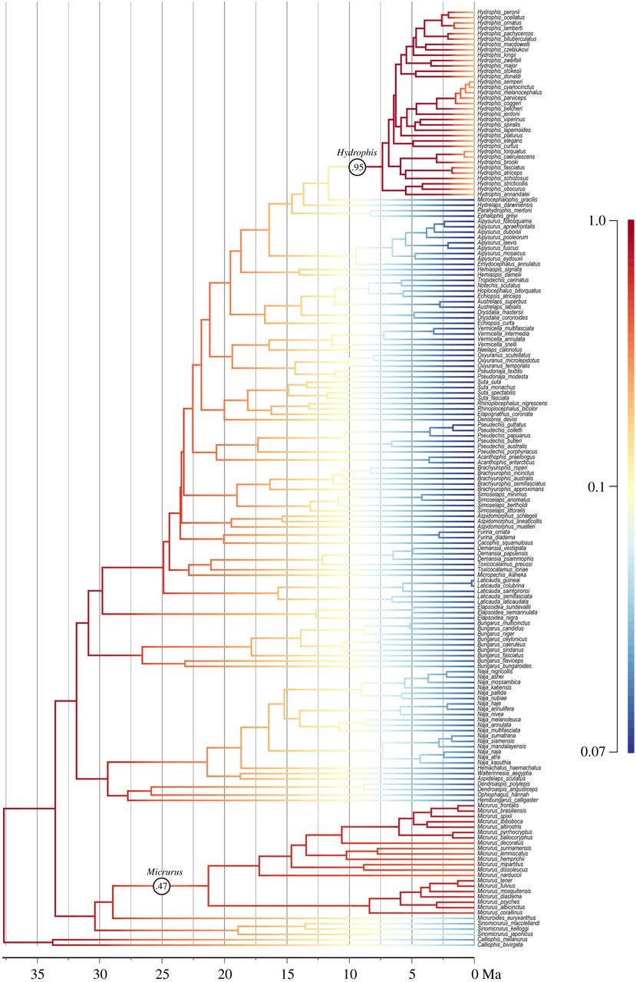
Let’s take a look at speciation rate without considering habitat (Results from BAMM)
Evidence for rapid speciation in Hydrophis, but not other seasnakes
Lee et al. 2016

Slide 12
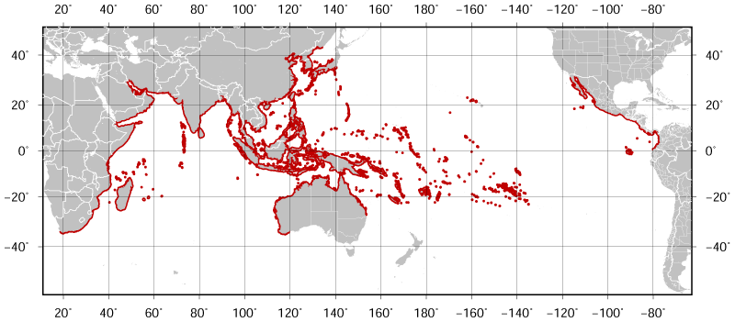
Elevated rates of speciation in Hydrophis
Elevated rates only in a subgroup of seasnakes - Hydrophis
Sea kraits also entered the marine environment independently. This is an earlier event but led to only 8 species.
Does this mean the BiSSE results represent a false positive?
Laticauda
Still lay eggs, less extreme adaptation to the marine environment
Hydrophis
Some members have wide ranges

Slide 13
Hidden state models can be used to construct appropriate null models for BiSSE
BiSSE might be supported over a null model without state dependent diversification simply because it contains at least some diversification rate heterogeneity
A better comparison is to a model which contains the same amount of diversification rate heterogeneity, but where this is not linked to the traits
Diversification rate
Diversification rate
Diversification rate
λ
μ
λ
μ
λ
μ
0A
0
0
0B
state
state
state
1A
1
1
1B
Standard null model
Alternative model (BiSSE)
Null model with hidden states

Slide 14
library(hisse)
trans.rates.bisse <-TransMatMaker(hidden.states=FALSE)
trans.rates.bisse
trans.rates.bisse.eq <- ParEqual(trans.rates.bisse, c(1,2))
turnover.anc.bisse <- c(1,2,0,0)
eps.anc <- c(0,0,0,0)
Diversification rate
λ
μ
*Note that here the model is parameterised using net diversification and extinction fraction rather than using speciation and extinction directly
Here we set up a very simple 3 parameter BiSSE model with no extinction and equal transition rates
0
1

Slide 15
library(hisse)
trans.rates.bisse <-TransMatMaker(hidden.states=FALSE)
trans.rates.bisse
trans.rates.bisse.eq <- ParEqual(trans.rates.bisse, c(1,2))
turnover.anc.bisse <- c(1,2,0,0)
eps.anc <- c(0,0,0,0)
pp.bisse <- hisse(tree, df, f=c(0.42,0.68), hidden.states=FALSE, turnover.anc=turnover.anc.bisse, eps.anc=eps.anc, trans.rate=trans.rates.bisse.eq, output.type="net.div")
Run the model
Have a look at the parameters and AIC
0A
1A
0B
1B

Slide 16
library(hisse)
trans.rates.bisse <-TransMatMaker(hidden.states=FALSE)
trans.rates.bisse
trans.rates.bisse.eq <- ParEqual(trans.rates.bisse, c(1,2))
turnover.anc.bisse <- c(1,2,0,0)
eps.anc <- c(0,0,0,0)
pp.bisse <- hisse(tree, df, f=c(0.42,0.68), hidden.states=FALSE, turnover.anc=turnover.anc.bisse, eps.anc=eps.anc, trans.rate=trans.rates.bisse.eq, output.type="net.div")
pp.bisse.recon <- MarginRecon(phy=tree, data=df, f = pp.bisse$f,
pars = pp.bisse$solution, aic = pp.bisse$AIC, n.cores=1)
plot(pp.bisse.recon, fsize=0.5)
Run an ancestral state reconstruction using this model and plot it
mac users can set n.cores>1

Slide 17
library(hisse)
trans.rates.bisse =TransMatMaker(hidden.states=FALSE)
trans.rates.bisse
trans.rates.bisse.eq <- ParEqual(trans.rates.bisse, c(1,2))
turnover.anc.bisse <- c(1,2,0,0)
eps.anc <- c(0,0,0,0)
pp.bisse = hisse(tree, df, f=c(0.42,0.68), hidden.states=FALSE, turnover.anc=turnover.anc.bisse, eps.anc=eps.anc, trans.rate=trans.rates.bisse.eq, output.type="net.div")
pp.bisse.recon <- MarginRecon(phy=tree, data=df, f = pp.bisse$f,
pars = pp.bisse$solution, aic = pp.bisse$AIC, n.cores=1)
plot(pp.bisse.recon, fsize=0.5)
source("trans.rates.null.R")
trans.rates =TransMatMaker(hidden.states=TRUE)
trans.rates.nodual =ParDrop(trans.rates,c(3,5,8,10))
trans.rates.nodual.allequal =
ParEqual(trans.rates.nodual,c(1,2,1,3,1,4,1,5,1,6,1,7,1,8))
trans.rates.nodual.allequal
turnover.anc.null <- c(?,?,?,?)
pp.null <- hisse(tree, df, f=c(0.42,0.68), hidden.states=TRUE, turnover.anc=turnover.anc.null, eps.anc=eps.anc,
trans.rate=trans.rates.nodual.allequal, output.type="net.div")
full hisse
0A
1A
0B
1B
BiSSE
0A
1A
0B
1B
null model
0A
1A
0B
1B
0A
1A
0B
1B

Slide 18
library(hisse)
trans.rates.bisse =TransMatMaker(hidden.states=FALSE)
trans.rates.bisse
trans.rates.bisse.eq <- ParEqual(trans.rates.bisse, c(1,2))
turnover.anc.bisse <- c(1,2,0,0)
eps.anc <- c(0,0,0,0)
pp.bisse = hisse(tree, df, f=c(0.42,0.68), hidden.states=FALSE, turnover.anc=turnover.anc.bisse, eps.anc=eps.anc, trans.rate=trans.rates.bisse.eq, output.type="net.div")
pp.bisse.recon <- MarginRecon(phy=tree, data=df, f = pp.bisse$f,
pars = pp.bisse$solution, aic = pp.bisse$AIC, n.cores=1)
plot(pp.bisse.recon, fsize=0.5)
source("trans.rates.null.R")
turnover.anc.null <- c(1,1,2,2)
pp.null <- hisse(tree, df, f=c(0.42,0.68), hidden.states=TRUE, turnover.anc=turnover.anc.null, eps.anc=eps.anc,
trans.rate=trans.rates.nodual.allequal, output.type="net.div")
pp.null.recon <- MarginRecon(phy=tree, data=df, f = pp.null$f,
pars = pp.null$solution, aic = pp.null$AIC, n.cores=1)
plot(pp.null.recon, fsize=0.5)
Run an ancestral state reconstruction using this model and plot it
mac users can set n.cores>1

Slide 20
library(hisse)
trans.rates.bisse =TransMatMaker(hidden.states=FALSE)
trans.rates.bisse
trans.rates.bisse.eq <- ParEqual(trans.rates.bisse, c(1,2))
turnover.anc.bisse <- c(1,2,0,0)
eps.anc <- c(0,0,0,0)
pp.bisse <- hisse(tree, df, f=c(0.42,0.68), hidden.states=FALSE, turnover.anc=turnover.anc.bisse, eps.anc=eps.anc, trans.rate=trans.rates.bisse.eq, output.type="net.div")
pp.bisse.recon <- MarginRecon(phy=tree, data=df, f = pp.bisse$f,
pars = pp.bisse$solution, aic = pp.bisse$AIC, n.cores=1)
plot(pp.bisse.recon, fsize=0.5)
source(“trans.rates.null.R”)
turnover.anc.null <- c(1,1,2,2)
pp.null <- hisse(tree, df, f=c(0.42,0.68), hidden.states=TRUE, turnover.anc=turnover.anc.null, eps.anc=eps.anc,
trans.rate=trans.rates.nodual.allequal, output.type="net.div")
starting.vals <- c(0.01, 0, 0.002)
pp.null <- hisse(tree, df, f=c(0.42,0.68), hidden.states=TRUE, turnover.anc=turnover.anc.null, eps.anc=eps.anc, trans.rate=trans.rates.nodual.allequal, output.type="net.div", starting.vals=starting.vals)

Slide 21
library(hisse)
trans.rates.bisse =TransMatMaker(hidden.states=FALSE)
trans.rates.bisse
trans.rates.bisse.eq <- ParEqual(trans.rates.bisse, c(1,2))
turnover.anc.bisse <- c(1,2,0,0)
eps.anc <- c(0,0,0,0)
pp.bisse <- hisse(tree, df, f=c(0.42,0.68), hidden.states=FALSE, turnover.anc=turnover.anc.bisse, eps.anc=eps.anc, trans.rate=trans.rates.bisse.eq, output.type="net.div")
pp.bisse.recon <- MarginRecon(phy=tree, data=df, f = pp.bisse$f,
pars = pp.bisse$solution, aic = pp.bisse$AIC, n.cores=1)
plot(pp.bisse.recon, fsize=0.5)
source(“trans.rates.null.R”)
turnover.anc.null <- c(1,1,2,2)
pp.null <- hisse(tree, df, f=c(0.42,0.68), hidden.states=TRUE, turnover.anc=turnover.anc.null, eps.anc=eps.anc,
trans.rate=trans.rates.nodual.allequal, output.type="net.div")
starting.vals <- c(0.01, 0, 0.002)
pp.null <- hisse(tree, df, f=c(0.42,0.68), hidden.states=TRUE, turnover.anc=turnover.anc.null, eps.anc=eps.anc, trans.rate=trans.rates.nodual.allequal, output.type="net.div", starting.vals=starting.vals)
pp.null.recon <- MarginRecon(phy=tree, data=df, f = pp.null$f,
pars = pp.null$solution, aic = pp.null$AIC, n.cores=1)
plot(pp.null.recon, fsize=0.5)

Slide 22
library(hisse)
trans.rates.bisse =TransMatMaker(hidden.states=FALSE)
trans.rates.bisse
trans.rates.bisse.eq <- ParEqual(trans.rates.bisse, c(1,2))
turnover.anc.bisse <- c(1,2,0,0)
eps.anc <- c(0,0,0,0)
pp.bisse <- hisse(tree, df, f=c(0.42,0.68), hidden.states=FALSE, turnover.anc=turnover.anc.bisse, eps.anc=eps.anc, trans.rate=trans.rates.bisse.eq, output.type="net.div")
pp.bisse.recon <- MarginRecon(phy=tree, data=df, f = pp.bisse$f,
pars = pp.bisse$solution, aic = pp.bisse$AIC, n.cores=1)
plot(pp.bisse.recon, fsize=0.5)
source(“trans.rates.null.R”)
turnover.anc.null <- c(1,1,2,2)
pp.null <- hisse(tree, df, f=c(0.42,0.68), hidden.states=TRUE, turnover.anc=turnover.anc.null, eps.anc=eps.anc,
trans.rate=trans.rates.nodual.allequal, output.type="net.div")
starting.vals <- c(0.01, 0, 0.002)
pp.null <- hisse(tree, df, f=c(0.42,0.68), hidden.states=TRUE, turnover.anc=turnover.anc.null, eps.anc=eps.anc, trans.rate=trans.rates.nodual.allequal, output.type="net.div", starting.vals=starting.vals)
pp.null.recon <- MarginRecon(phy=tree, data=df, f = pp.null$f,
pars = pp.null$solution, aic = pp.null$AIC, n.cores=1)
plot(pp.null.recon, fsize=0.5)
hisse.results.list <- list()
hisse.results.list[[1]] <- pp.bisse.recon
hisse.results.list[[2]] <- pp.null.recon
plot.hisse.states(hisse.results.list, rate.param="net.div", fsize=0.5)
Model averaging
We can produce an ancestral state reconstruction that averages over the models, weighted by their AIC scores

Slide 23
FiSSE
data[,2] -> chars
data[,1] -> names(chars)
make.bisse(tree, chars) -> bisse6
starting.point.bisse(tree) -> start
find.mle(bisse6, start) -> ml6
constrain(bisse6, mu1 ~ mu0) -> bisse5
constrain(bisse6, lambda1 ~ lambda0, mu1 ~ mu0) -> bisse4
find.mle(bisse5, start) -> ml5
find.mle(bisse4, start) -> ml4
ml6$lnLik
ml5$lnLik
ml4$lnLik
ml6$par -> start
find.mle(bisse6, start) -> ml6.1
find.mle(bisse5, start) -> ml5.1
find.mle(bisse4, start) -> ml4.1
ml6.1$lnLik
ml5.1$lnLik
ml4.1$lnLik
asr.marginal(bisse5.1, coef(ml5.1)) -> asr
source("nicetree.R”)
library(hisse)
trans.rates.bisse =TransMatMaker(hidden.states=FALSE)
trans.rates.bisse
trans.rates.bisse.eq <- ParEqual(trans.rates.bisse, c(1,2))
turnover.anc.bisse <- c(1,2,0,0)
eps.anc <- c(0,0,0,0)
pp.bisse = hisse(tree, data, f=c(0.42,0.68), hidden.states=FALSE, turnover.anc=turnover.anc.bisse, eps.anc=eps.anc, trans.rate=trans.rates.bisse.eq, output.type="net.div")
pp.bisse.recon <- MarginRecon(phy=tree, data=data, f = pp.bisse$f,
pars = pp.bisse$solution, aic = pp.bisse$AIC, n.cores=1)
plot(pp.bisse.recon, fsize=0.5)
trans.rates =TransMatMaker(hidden.states=TRUE)
trans.rates.nodual =ParDrop(trans.rates,c(3,5,8,10))
trans.rates.nodual.allequal =
ParEqual(trans.rates.nodual,c(1,2,1,3,1,4,1,5,1,6,1,7,1,8))
trans.rates.nodual.allequal
turnover.anc.null <- c(1,1,2,2)
pp.null <- hisse(tree, data, f=c(0.42,0.68), hidden.states=TRUE, turnover.anc=turnover.anc.null, eps.anc=eps.anc,
trans.rate=trans.rates.nodual.allequal, output.type="net.div")
c(0.01, 0, 0.002) -> starting.vals
pp.null <- hisse(tree, data, f=c(0.42,0.68), hidden.states=TRUE, turnover.anc=turnover.anc.null, eps.anc=eps.anc, trans.rate=trans.rates.nodual.allequal, output.type="net.div", starting.vals=starting.vals)
pp.null.recon <- MarginRecon(phy=tree, data=data, f = pp.null$f,
pars = pp.null$solution, aic = pp.null$AIC, n.cores=1)
plot(pp.null.recon, fsize=0.5)
hisse.results.list = list()
hisse.results.list[[1]] = pp.bisse.recon
hisse.results.list[[2]] = pp.null.recon
plot.hisse.states(hisse.results.list, rate.param="net.div", fsize=0.5)
source("traitDependent_functions.R")
res <- FISSE.binary(tree, v)
pval <- min(res$pval, 1-res$pval)*2
pval
Do the results from this simple test agree with those from BiSSE?
What do we conclude now about the effect of entering the marine environment on seasnake diversification

Slide 24
Take-home messages
Implementations of models (e.g. BiSSE in R) are not always perfect, for example do not find maximum likelihood
BiSSE and other methods can only choose amongst the models available to it
It is possible that none of the models tested are good
Critical thinking must be applied to all comparative methods
Common sense and biology still have a role to play!

